Slide 1
6.1: Verifying Trigonometric Identities
MATH 1550 - Precalculus

Slide 2
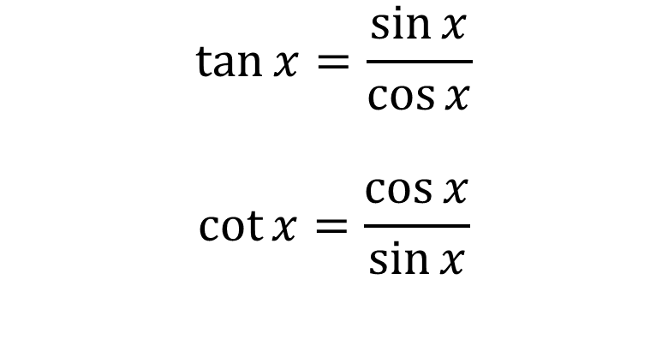
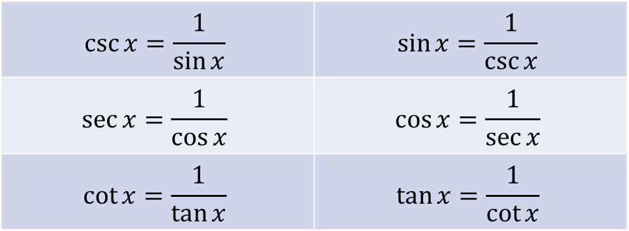
Trig Identities We’ve Seen So Far
Reciprocal Identities
Quotient Identities
$$\csc{x}=\frac{1}{\sin{x}}$$ | $$\sin{x}=\frac{1}{\csc{x}}$$
$$\sec{x}=\frac{1}{\cos{x}}$$ | $$\cos{x}=\frac{1}{\sec{x}}$$
$$\cot{x}=\frac{1}{\tan{x}}$$ | $$\tan{x}=\frac{1}{\cot{x}}$$
$$\tan{x=\frac{\sin{x}}{\cos{x}}}$$
$$\cot{x}=\frac{\cos{x}}{\sin{x}}$$

Slide 3
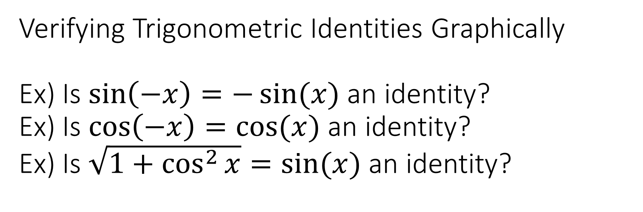
Verifying Trigonometric Identities Graphically Ex) Is $\sin\left(−x\right)=−\sin{(x)}$ an identity? Ex) Is $\cos\left(−x\right)=\cos{(x)}$ an identity? Ex) Is $\sqrt{1+\cos^{2}{x}}=sin⁡(x)$ an identity?
Yes! The graphs match
Yes! The graphs match
No. The graphs don’t match almost everywhere

Slide 4

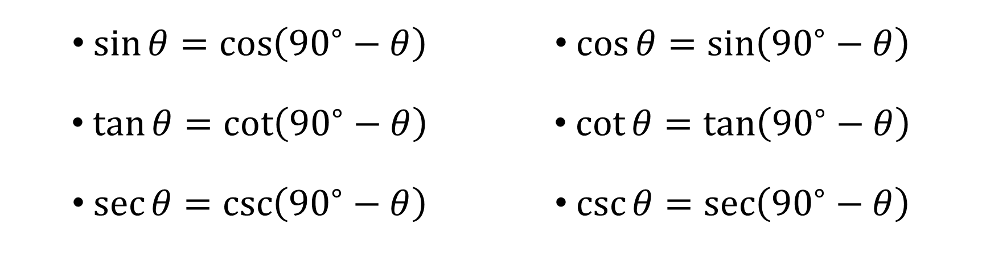
Cofunction Identities
$\sin{θ}=\cos\left({90}^{∘}−θ\right)$
$\tan{θ}=\cot\left({90}^{∘}−θ\right)$
$\sec{θ}=\csc\left({90}^{∘}−θ\right)$
$\cos{θ}=\sin\left({90}^{∘}−θ\right)$
$\cot{θ}=\tan\left({90}^{∘}−θ\right)$
$\csc{θ}=\sec\left({90}^{∘}−θ\right)$
$$θ$$

Slide 5
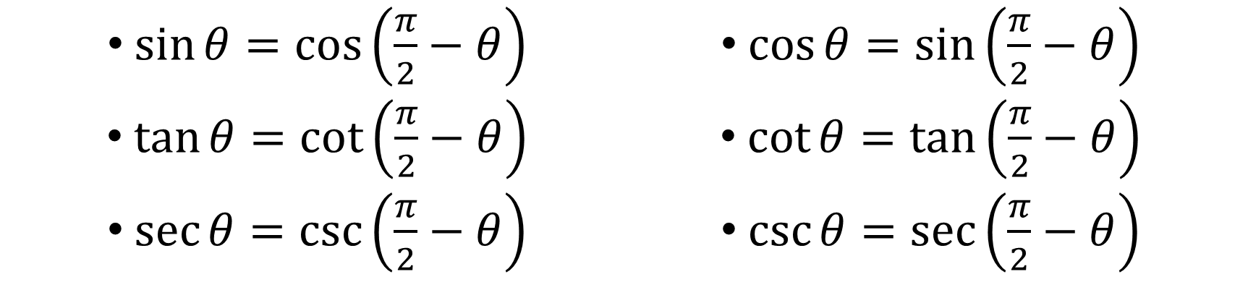
Cofunction Identities (In Radians)
$\sin{θ}=\cos\left(\frac{π}{2}−θ\right)$
$\tan{θ}=\cot\left(\frac{π}{2}−θ\right)$
$\sec{θ}=\csc\left(\frac{π}{2}−θ\right)$
$\cos{θ}=\sin\left(\frac{π}{2}−θ\right)$
$\cot{θ}=\tan\left(\frac{π}{2}−θ\right)$
$\csc{θ}=\sec\left(\frac{π}{2}−θ\right)$
$$θ$$

Slide 6
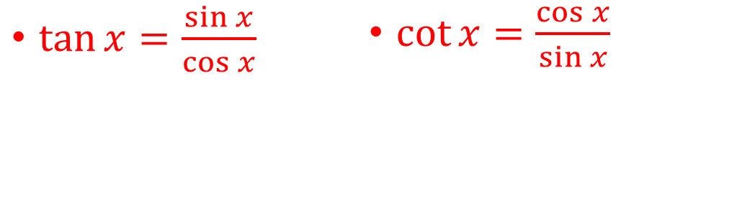
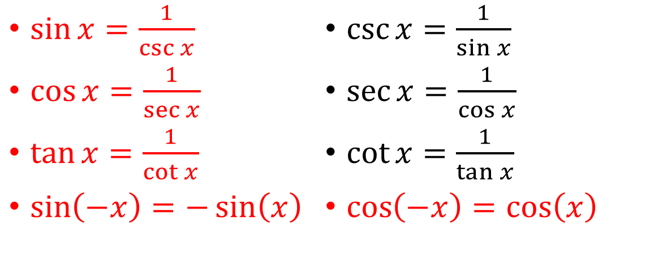

Major Trigonometric Identities Thus Far
$\sin{x}=\frac{1}{\csc{x}}$
$\cos{x}=\frac{1}{\sec{x}}$
$\tan{x}=\frac{1}{\cot{x}}$
$\sin\left(−x\right)=−\sin\left(x\right)$
$\csc{x}=\frac{1}{\sin{x}}$
$\sec{x}=\frac{1}{\cos{x}}$
$\cot{x}=\frac{1}{\tan{x}}$
$\cos\left(−x\right)=\cos\left(x\right)$
$\tan{x=\frac{\sin{x}}{\cos{x}}}$
$\cot{x}=\frac{\cos{x}}{\sin{x}}$
$\sin^{2}{x}+\cos^{2}{x}=1$
$\tan^{2}{x}+1=\sec^{2}{x}$
$1+\cot^{2}{x}=\csc^{2}{x}$

